Slide 1


KGiSL Institute of Technology
(An Autonomous Institution)
Affiliated to Anna University, Approved by AICTE, Recognized by UGC,
Accredited by NAAC & NBA (B.E-CSE,B.E-ECE, B.Tech-IT),
365, KGiSL Campus, Thudiyalur Road, Saravanampatti, Coimbatore – 641035
VIVA VOCE
USER BEHAVIOUR ANALYSIS FOR DATA DRIVEN DECISION MAKING
TEAM NO 17
TEAM MEMBERS
1.Sahaana k – 711721243086
2.Srinath R – 711721243108
3. Swetha S – 711721243114
4.Vasantha Krishnan -711721243120
GUIDED BY
Ms. Ramani P
AP/Dept of AI&DS

Slide 2

ABSTRACT
This project creates a real-time system to track and analyze user behavior on websites. It uses Apache Kafka for streaming data, Redis for quick access, Cassandra for large-scale storage, and PySpark for fast data processing. User actions like clicks and navigation are collected and shown through Power BI dashboards. These insights help businesses improve marketing, personalize user experiences, and make smarter decisions, all while ensuring speed, scalability, and data security.

Slide 3
EXISTING SYSTEM
The existing system of the U.K. fast-fashion retailer includes an e-commerce website, where consumer behavior is tracked using Adobe Analytics. Clickstream data from 10% of website visits in March 2018,totaling 1,438,333 unique visits, is analyzed to understand consumer interactions. Website entry patterns are categorized based on device type (desktop or mobile) and traffic sources such as ads, referrals, shopping sites, internal links, social media, email, and search engines. Browsing behavior is assessed through metrics like past visits, total pages viewed, time spent per page, and overall session duration. Exit behavior is monitored to determine whether consumers added items to the cart and completed a purchase, with revenue data also recorded. This system enables a deeper understanding of consumer segments, supporting marketing strategies and decision-making.

Slide 4
PROBLEM IDENTIFIED IN EXISTING SYSTEM
No Demographic Data: Lacks consumer info like age and gender, limiting segment insights.
Incomplete Journey Analysis: Does not track full customer journey or conversion touchpoints.
Single Data Source: Relies only on Adobe Analytics, limiting integration with other platforms.
Scalability Issues: Current methods may not handle real-time processing of growing data volumes.
Limited Generalizability: Based on one U.K. retailer—findings may not apply to other regions or markets.

Slide 5
.
PROPOSED SYSTEM
Goal: Efficiently track and analyze high-frequency user interactions in real time.
Technologies Used: Apache Kafka (data streaming), Cassandra (scalable storage), MySQL (temporary storage), Python (analytics), Power BI (visualization).
How It Works:
Data Flow: Web/mobile apps → Kafka → Processing (Python) → Cassandra → BI Dashboards.
Kafka: Enables high-throughput, fault-tolerant data streaming via a publish-subscribe model.
Cassandra: Stores large volumes of processed user interaction data.
Outcome: Identifies trends like product popularity, session duration, and engagement patterns to deliver actionable insights that enhance marketing strategies and user experience.

Slide 6
LITERATURE SURVEY
Data Streaming & Storage:
  Apache Kafka: Efficient real-time data streaming (Gupta et al., 2021; Kreps et al., 2011).
  Apache Cassandra: Scalable, distributed data storage (Lakshman & Malik, 2010; Patel & Kumar, 2020).
Big Data Processing:
  MapReduce & HDFS: Enable large-scale data handling (Dean & Ghemawat, 2008; Shvachko et al., 2010).
  Stream Processing: Apache Flink, Twitter Storm for continuous analytics (Carbone et al., 2015; Toshniwal et al., 2014).
E-commerce Applications:
  Clickstream Analysis: Tracks navigation patterns and segments users (Zhang et al., 2019; Liu et al., 2018).
  AI Techniques: ML/DL for behavior modeling and personalized recommendations (Chen et al., 2016; Zhang et al., 2020).

Slide 7
LITERATURE SURVEY
Clickstream Analytics
  Used to study consumer navigation patterns and segment behaviors (Zhang et al., 2019; Liu et al., 2018)
  Existing studies often descriptive; limited in predictive insights for decision-making
Real-Time Data Technologies
  Apache Kafka: Real-time data streaming for high-frequency events (Kreps et al., 2011; Gupta et al., 2021)
  Apache Cassandra: Scalable NoSQL storage for large datasets (Lakshman & Malik, 2010)
Big Data Frameworks
  Hadoop & MapReduce: Batch processing for large-scale data (Shvachko et al., 2010)
  Apache Flink, Storm: Enable continuous stream processing (Carbone et al., 2015; Toshniwal et al., 2014)
Machine Learning in E-commerce
  Applied for personalized recommendations and behavioral prediction (Chen et al., 2016; Zhang et al., 2020)
Research Gap
  Limited integration of clickstream data into real-time marketing strategies
  Need for deeper behavioral segmentation and linkage to revenue impact
:

Slide 8
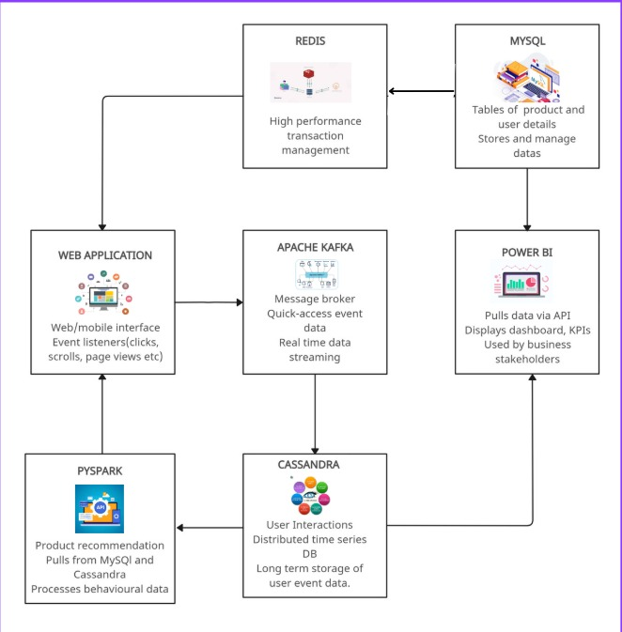
ARCHITECTURAL DIAGRAM

Slide 9
DATA MODELS
Table Name | Key Fields
User | User_ID, Name, Email, Device_Type, Location
Session | Session_ID, User_ID, Start_Time, End_Time, Device_Type, Traffic_Source
Event | Event_ID, Session_ID, Event_Type (click, scroll, purchase), Timestamp, Page_URL
Product | Product_ID, Name, Category, Price, Stock_Status
Transaction | Transaction_ID, User_ID, Product_ID, Quantity, Total_Amount, Payment_Method
Analytics | Segment_ID, User_ID, Engagement_Score, Conversion_Probability

Slide 10
LIST OF MODULES
Data Collection:
Captures clicks, views, and search activity.
Streaming:
Kafka handles real-time event processing.
Storage:
MySQL for short-term; Cassandra for scalable long-term storage.
Analytics:
Python-based engines extract behavioral insights.
Visualization:
Power BI dashboards show engagement and trends.
Security:
Data encryption and access control ensure compliance.

Slide 11
MODULAR DESCRIPTION
Data Collection
Captures clicks/views via JavaScript; validated by Python backend
.
Real-Time Streaming
Kafka for ingestion; Redis for in-memory buffering.
Data Storage
MySQL for structured data; Cassandra for scalable storage.
Analytics & Processing
PySpark for trend analysis, segmentation, and predictions.
Visualization & Reporting
Power BI dashboards for engagement and usage insights.
Security & Compliance
Encryption and policy checks to protect user data.
.

Slide 12
Novelty
Real-Time Data Streaming
Captures user interactions instantly using Apache Kafka with minimal latency.
Hybrid Storage Model
Combines MySQL (temporary), Cassandra (scalable), and Redis (in-memory caching) for performance and flexibility.
PySpark-Based Analytics
Enables scalable, distributed trend analysis and predictive modeling on large datasets.
Interactive Dashboards
Uses Power BI for real-time, actionable visualizations of user engagement and behavior.
Session Optimization
Redis integration improves session management and data retrieval speeds.
Privacy & Compliance Ready
Implements encryption, access controls, and adheres to GDPR/CCPA standards.

Slide 13
Future Scope
1.Integration with Machine Learning Models
2.Real-Time Alerting System
3.Cross-Platform Data Collection
4.Cloud Deployment & Scalability
5.Advanced Visualizations
6.Privacy Enhancements
OMD552/HWM/III AI&DS/V SEM/KG-KiTE

Slide 14
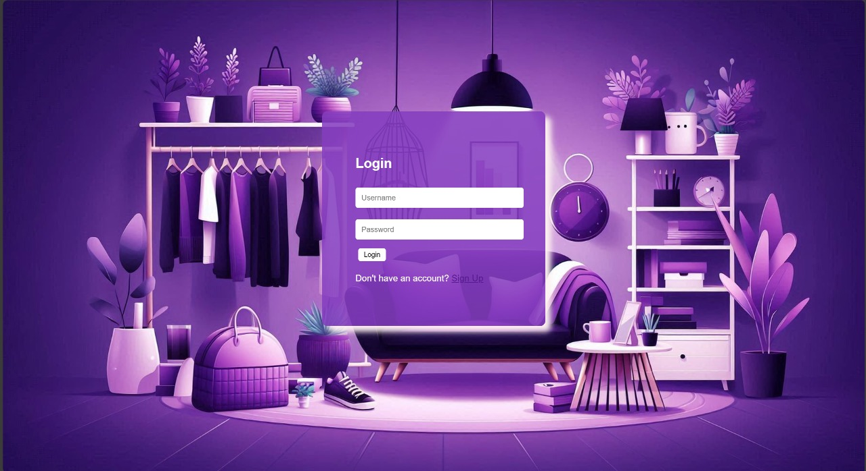
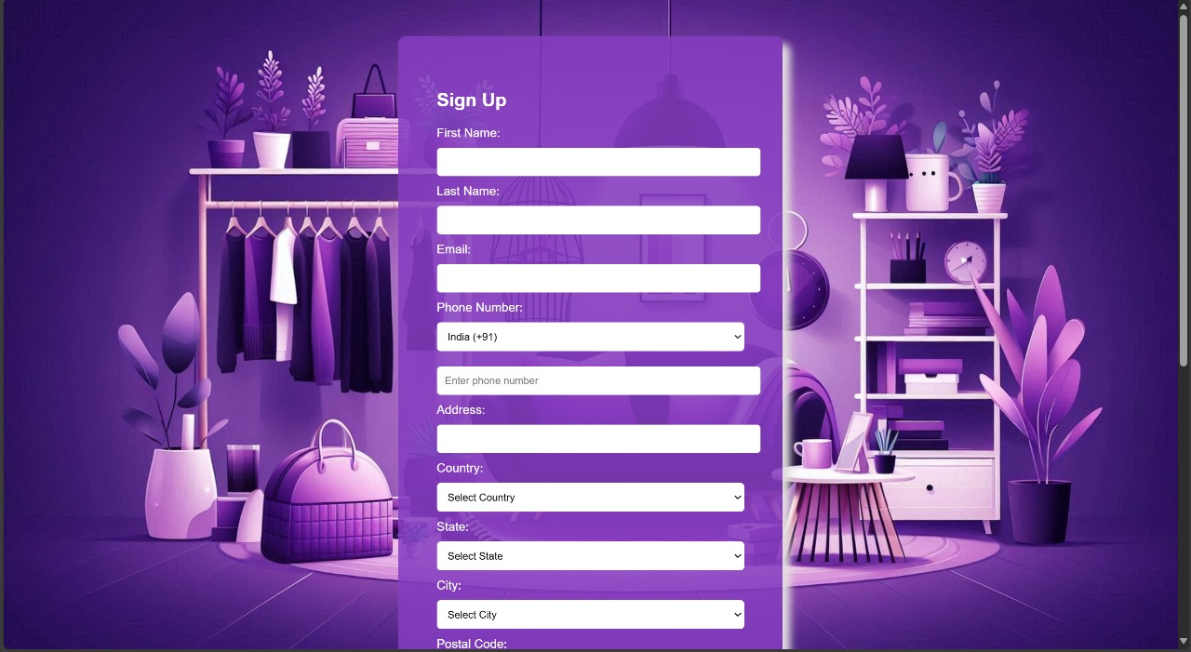
SAMPLE SCREENSHOTS
Figure 1.0 - Login Page
Figure 1.1- Sign up Page

Slide 15
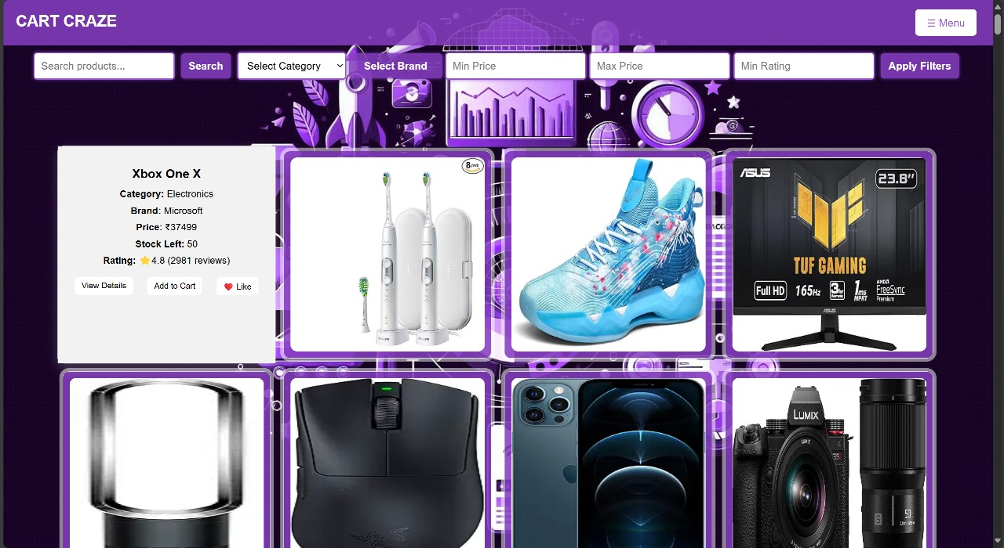
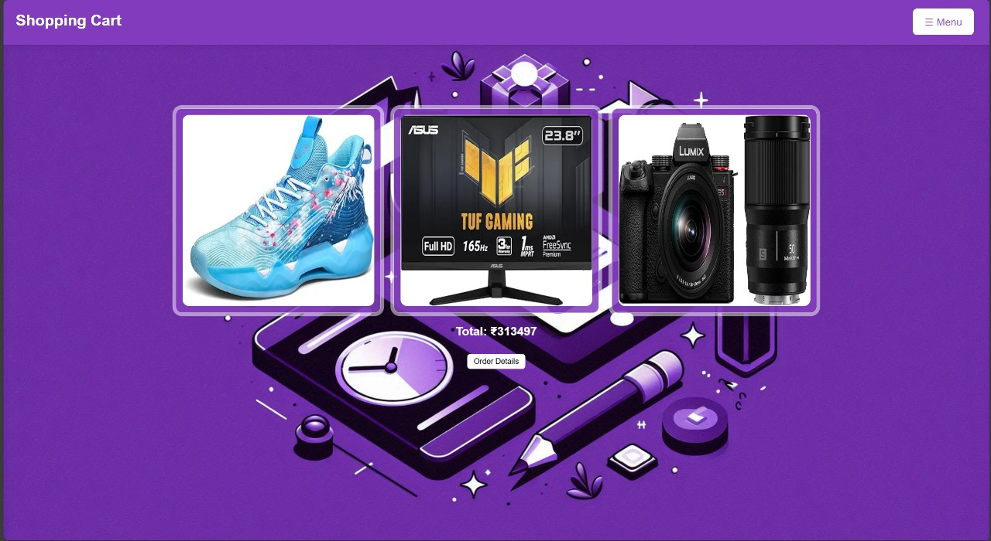
SAMPLE SCREENSHOTS
Figure 2.0 - Home Page
Figure 2.1 - Cart page

Slide 16
THANK YOU

